Slide 1
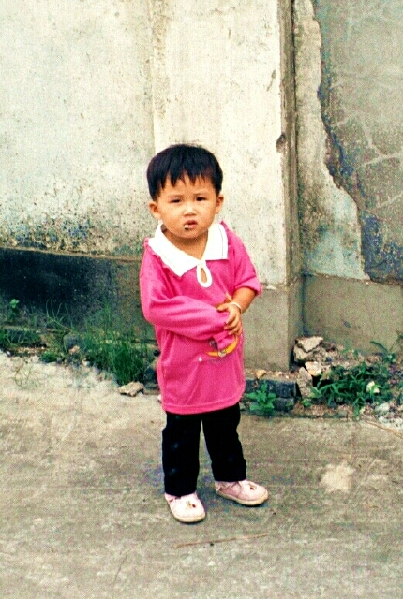
Chapter 5
Human Development

Slide 2
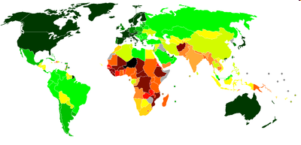
Human Development Index (UNDP)
Mahbub ul Haq: Founder HD Report
Geometric mean of 3 indices (Sen):
  Life expectancy
  Education
  GDP (log transformation)
Lowest: Black-Red
Highest: Dark Green

Slide 3
Why the Ln of Income?
P/cap Incomes ranged from $260 (Liberia) to $93,383 (Qatar)
  That’s really big
Would an increase in income in rich countries affect human development as much as the same increase in poor countries? (No)
The natural log compresses the income range
  Ln(260) = 5.56 (Liberia) and Ln(93,383) = 11.44 (Qatar).

Slide 4
An Index of Indexes
Education Index:
HDI:
EYSC: Expected Years of School Completion
MYSA: Mean Years of School Attainment
E: Education
GNI: (Ln) of Gross Domestic Income
LE: Life Expectancy

Slide 5
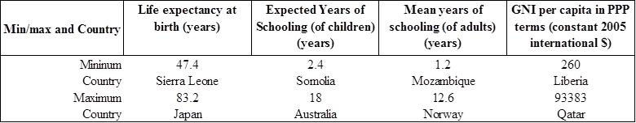
Human Development Highs and Lows

Slide 6
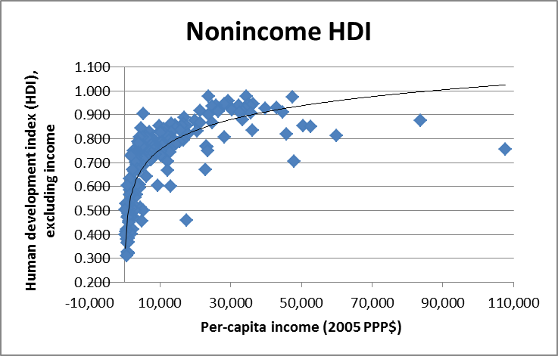
HDI and Income

Slide 7
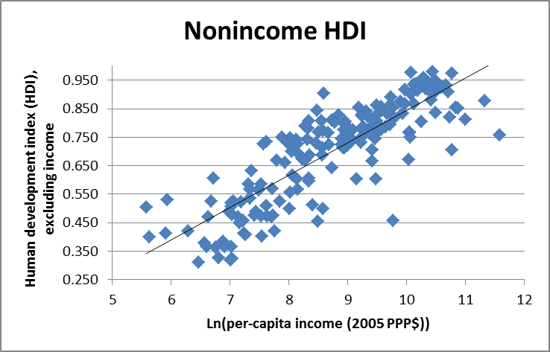
HDI and (Ln) Income

Slide 8
Why the Variation?
Non-economic factors?
  E.g., Swaziland and Ukraine have similar levels of per-capita GDP ($4,300, PPP)
  But HIV/AIDS lowered life expectancy to 38 years in Swaziland (vs. 69 yrs in Ukraine)
Education and other policies?
  Algeria and Panama ~$6,000
  But 92% of Panamanians are literate vs. 68% of Algerians
Inequality? According to the World Bank:
  Panama: Gini = 51.9
  Algeria: Gini = 35.3

Slide 9
The Best and the Worst at Turning Income into Human Development

Slide 10
Delving into the HDI’s Components
Income (Chapter 2) and income growth (Chapter 6)
Education
Health
Supplemental Reading for Chapter 5

Slide 11
Big Challenges: Positive Externalities and Public Goods

Slide 12
Educating a Country
Externalities of schooling
  Left to own devices, people underinvest in schooling under the best of circumstances
  The reason for public education
Poor countries aren’t the best of circumstances
  High costs of sending kids to school
    Cash
    Opportunity costs
If you make education available to everyone (like massive online open courses—MOOC), how do you make a profit?
  All costs are fixed, like a bridge; IRS

Slide 13
Making a Country Healthy
When you are healthy, you and the people you work with are more productive.
  When you are not, you can make others sick
When investing in health, do people consider the benefits and costs for the rest of society?
  Free-rider problem: Should I get vaccinated if you do?
IRS: Public health projects have high fixed costs then low or negligible marginal costs
  Potable water systems, sanitation, vaccinations, disease prevention
  Marginal-cost pricing doesn’t work (like bridges)

Slide 14
Costs
Cash costs (fixed costs and maintenance costs)
Opportunity costs
  What’s the next best thing you could be doing with the money?
    Build clinics or school rooms?
    Run a public information campaign to reduce HIV?
    Give cash transfers to poor households?
    Build a new airport that can bring tourists in?
    Put in new roads or cell towers?
  They’re all important; how do we choose?
  How can we estimate opportunity costs?
    Compare benefits from other uses of money and time

Slide 15
Benefits: Usually a Lot Harder
How do you quantify the economic benefits of a public health or education project?
  Lives saved; what’s the ECONOMIC value of a life?
  Healthy people are more productive
  Human capital theory…
Of a new road, cell tower, or airport?
  How much new income will these create?

Slide 16
Discounting
Costs happen right away, but we have to wait to see the benefits
Income in the future is worth less than now
  …so we have to discount
Need a discount rate, r—the opportunity cost of money
  What’s the opportunity cost of money?
    Value of next-highest alternative use of money
    The interest rate, the benefit of investing in something else, etc.
    What if there is no bank?
Lesotho: interest rate = .044 (or 4.4%) in 2012
  Development banks often use 12% to evaluate their projects
  What does a higher discount rate do to a Cost-benefit analysis?
Need to calculate present value of any future benefits and costs.

Slide 17
Present Value
The present value (PV) of $100 a year from now is $100/(1+r)
  If r=.05, we get $100/1.05 = $95.24
  If TWO years from now, $100/(1+r)²
In general, the PV of income Y received at time t is:

Slide 18
Net Present Value of an Investment
If NPV>0 the investment (project) passes the cost-benefit test
The trick is always figuring out the benefits and costs
  …and attach a dollar value to them.

Slide 19
A Private Cost-benefit Analysis of Going to School
You’re a kid in a poor village in Lesotho
Just finished 6th grade
Should you go on and complete secondary school (grades 7-9)?
What are the costs and benefits of going to school?

Slide 20
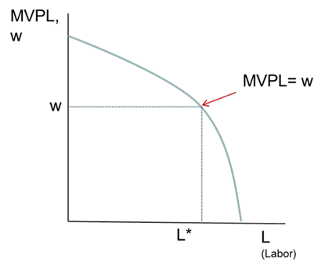
Benefits: Human Capital Theory
(Gary Becker, Jacob Mincer)
Wage=marginal value product of labor:
The Mincer Equation: Wages thus depend on schooling (S) and work experience (EXP):
The (private) returns to schooling

Slide 21
Benefits and Opportunity Costs in a Lesotho Village
Mincer wage equation: each additional year of schooling raises the wage by 9.8% for males and 18.6% for females
  So 3 years => 29% and 56%, respectively
Opportunity cost: Average annual wage, <16 years old: 487 maloti (around US$64) per year for boys and 279 maloti (US$52) for girls
  There are cash costs, too, but for simplicity we ignore them

Slide 22
Cost-Benefit Analysis
NPV (Sum)=958
NPV (Sum)=2816

Slide 23
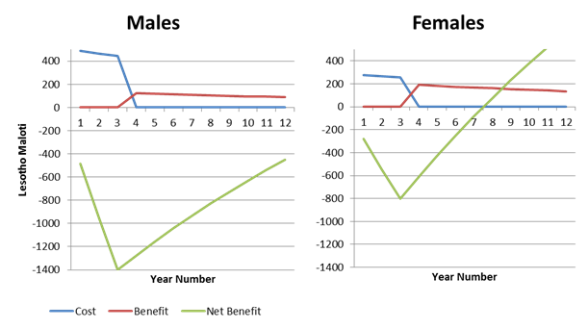
NPV=958 (Boys) and 2816 (Girls).
Is It Worth the Wait?
A big “if”: What if educated kids migrate?
  They won’t be in our analysis
  Are we under-estimating the economic benefits of education for rural kids?

